Slide 1

BLOCKCHAIN
Basic Concepts and
Definitions
Prof. Sunitha R
Department of Computer Science Engineering

Slide 2

BLOCKCHAIN
Blockchain Key Concepts
Prof. Sunitha R
Department of Computer Science Engineering

Slide 3
BLOCKCHAIN
Learning Content
Learn about the History, importance and various types of public ledger.
Notes:
A distributed ledger is a database that is consensually shared and synchronized across multiple sites, institutions, or geographies, accessible by multiple people. It allows transactions to have public "witnesses". The participant at each node of the network can access the recordings shared across that network and can own an identical copy of it. Any changes or additions made to the ledger are reflected and copied to all participants in a matter of seconds or minutes.
When a buyer and a seller engages in a transaction, the blockchain verifies the authenticity of their accounts. This is done by using the public ledger and by checking if the funds are available proceeds with the transactions. However, if the funds are either not available in the buyer’s account or are promised to another party, then the sale is prevented effectively making double buying impossible. But where do they keep the public ledger?

Slide 4
BLOCKCHAIN
Public Ledger
The public ledger organizes into a long chain of blocks of information.
A distributed ledger is a database that is consensually shared and synchronized across multiple sites, institutions, or geographies, accessible by multiple people.
A distributed ledger stands in contrast to a centralized ledger, which is the type of ledger that most companies use.
Blockchain is a type of distributed ledger used by bitcoin.
Notes:
A distributed ledger is a database that is consensually shared and synchronized across multiple sites, institutions, or geographies, accessible by multiple people. It allows transactions to have public "witnesses". The participant at each node of the network can access the recordings shared across that network and can own an identical copy of it. Any changes or additions made to the ledger are reflected and copied to all participants in a matter of seconds or minutes.
When a buyer and a seller engages in a transaction, the blockchain verifies the authenticity of their accounts. This is done by using the public ledger and by checking if the funds are available proceeds with the transactions. However, if the funds are either not available in the buyer’s account or are promised to another party, then the sale is prevented effectively making double buying impossible. But where do they keep the public ledger?

Slide 5
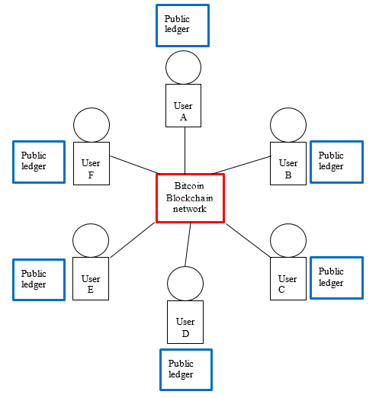
BLOCKCHAIN
Public Ledger
Notes:
A distributed ledger is a database that is consensually shared and synchronized across multiple sites, institutions, or geographies, accessible by multiple people. It allows transactions to have public "witnesses". The participant at each node of the network can access the recordings shared across that network and can own an identical copy of it. Any changes or additions made to the ledger are reflected and copied to all participants in a matter of seconds or minutes.
When a buyer and a seller engages in a transaction, the blockchain verifies the authenticity of their accounts. This is done by using the public ledger and by checking if the funds are available proceeds with the transactions. However, if the funds are either not available in the buyer’s account or are promised to another party, then the sale is prevented effectively making double buying impossible. But where do they keep the public ledger?

Slide 6
BLOCKCHAIN
Example
PL of Alice
PL of Bob
Notes:
A distributed ledger is a database that is consensually shared and synchronized across multiple sites, institutions, or geographies, accessible by multiple people. It allows transactions to have public "witnesses". The participant at each node of the network can access the recordings shared across that network and can own an identical copy of it. Any changes or additions made to the ledger are reflected and copied to all participants in a matter of seconds or minutes.
When a buyer and a seller engages in a transaction, the blockchain verifies the authenticity of their accounts. This is done by using the public ledger and by checking if the funds are available proceeds with the transactions. However, if the funds are either not available in the buyer’s account or are promised to another party, then the sale is prevented effectively making double buying impossible. But where do they keep the public ledger?

Slide 7
BLOCKCHAIN
History
Notes:
A distributed ledger is a database that is consensually shared and synchronized across multiple sites, institutions, or geographies, accessible by multiple people. It allows transactions to have public "witnesses". The participant at each node of the network can access the recordings shared across that network and can own an identical copy of it. Any changes or additions made to the ledger are reflected and copied to all participants in a matter of seconds or minutes.
When a buyer and a seller engages in a transaction, the blockchain verifies the authenticity of their accounts. This is done by using the public ledger and by checking if the funds are available proceeds with the transactions. However, if the funds are either not available in the buyer’s account or are promised to another party, then the sale is prevented effectively making double buying impossible. But where do they keep the public ledger?

Slide 8
BLOCKCHAIN
History
Notes:
A distributed ledger is a database that is consensually shared and synchronized across multiple sites, institutions, or geographies, accessible by multiple people. It allows transactions to have public "witnesses". The participant at each node of the network can access the recordings shared across that network and can own an identical copy of it. Any changes or additions made to the ledger are reflected and copied to all participants in a matter of seconds or minutes.
When a buyer and a seller engages in a transaction, the blockchain verifies the authenticity of their accounts. This is done by using the public ledger and by checking if the funds are available proceeds with the transactions. However, if the funds are either not available in the buyer’s account or are promised to another party, then the sale is prevented effectively making double buying impossible. But where do they keep the public ledger?

Slide 9
BLOCKCHAIN
History
Notes:
A distributed ledger is a database that is consensually shared and synchronized across multiple sites, institutions, or geographies, accessible by multiple people. It allows transactions to have public "witnesses". The participant at each node of the network can access the recordings shared across that network and can own an identical copy of it. Any changes or additions made to the ledger are reflected and copied to all participants in a matter of seconds or minutes.
When a buyer and a seller engages in a transaction, the blockchain verifies the authenticity of their accounts. This is done by using the public ledger and by checking if the funds are available proceeds with the transactions. However, if the funds are either not available in the buyer’s account or are promised to another party, then the sale is prevented effectively making double buying impossible. But where do they keep the public ledger?

Slide 10
BLOCKCHAIN
Features
Synchronized and accessible across different sites
Replace the need for a central authority
Cyber attacks and financial fraud are reduced
Notes:
A distributed ledger is a database that is consensually shared and synchronized across multiple sites, institutions, or geographies, accessible by multiple people. It allows transactions to have public "witnesses". The participant at each node of the network can access the recordings shared across that network and can own an identical copy of it. Any changes or additions made to the ledger are reflected and copied to all participants in a matter of seconds or minutes.
When a buyer and a seller engages in a transaction, the blockchain verifies the authenticity of their accounts. This is done by using the public ledger and by checking if the funds are available proceeds with the transactions. However, if the funds are either not available in the buyer’s account or are promised to another party, then the sale is prevented effectively making double buying impossible. But where do they keep the public ledger?

Slide 11
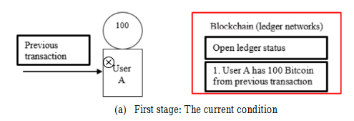
BLOCKCHAIN
Transaction Using Ledger
Notes:
shows the transaction procedure in cryptocurrency. A transaction is a transfer of Bitcoin value that is broadcast to the network and collected into blocks. A transaction typically references previous transaction outputs as new transaction inputs and dedicates all input Bitcoin values to new outputs. Bitcoin transaction defined as a chain of digital signatures.

Slide 12
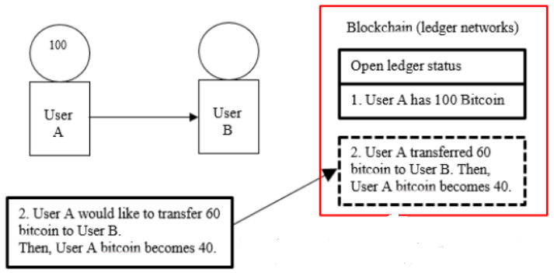
BLOCKCHAIN
Transaction Using Ledger
Notes:
shows the transaction procedure in cryptocurrency. A transaction is a transfer of Bitcoin value that is broadcast to the network and collected into blocks. A transaction typically references previous transaction outputs as new transaction inputs and dedicates all input Bitcoin values to new outputs. Bitcoin transaction defined as a chain of digital signatures.

Slide 13
BLOCKCHAIN
Transaction Using Ledger

Slide 14
BLOCKCHAIN
Types of Public Ledger
Public blockchain Ledger
Private Blockchain Ledger
Notes:
Public Blockchain Ledger
This blockchain is totally open to all and anybody can join the system. Each member on the chain has full power to access, read and write transactions. Since it is decentralized and wholly distributed, every node gives verification to approve any transaction. Data can’t be altered or manipulated once it is placed on the block. Public blockchains are also called permissionless blockchains.
Being totally open to everyone is the biggest drawback of this type of ledger, since it offers complete transparency with little privacy. Time taken to reach consensus by the network is high because of the numerous nodes present, therefore resulting in high computational power. Bitcoin, Ethereum, etc are popular examples.
Private blockchain Ledger
Also called permissioned blockchains, they have limitations on who is participating in the network. A user is granted access only by the network initiator or by a predefined set of rules. Once a user is given entrance to the network, it can perform the same duties as that of other users. Again, the degree of permissions is decided by the one who initiated the network.

Slide 15
BLOCKCHAIN
Differences
Permission-less blockchain ledger | Permissioned blockchain ledger
Open to everyone hence anyone can participate in the network | Only users who have been granted permission by network starter can join
More transparency, less privacy | More security, limited permissions
High computing power due to a greater number of users | Efficient and well organized due to limited number of users
E.g:- Bitcoin, Ethereum | E.g:- Hyperledger Fabric, Corda
Notes:
Public Blockchain Ledger
This blockchain is totally open to all and anybody can join the system. Each member on the chain has full power to access, read and write transactions. Since it is decentralized and wholly distributed, every node gives verification to approve any transaction. Data can’t be altered or manipulated once it is placed on the block. Public blockchains are also called permissionless blockchains.
Being totally open to everyone is the biggest drawback of this type of ledger, since it offers complete transparency with little privacy. Time taken to reach consensus by the network is high because of the numerous nodes present, therefore resulting in high computational power. Bitcoin, Ethereum, etc are popular examples.
Private blockchain Ledger
Also called permissioned blockchains, they have limitations on who is participating in the network. A user is granted access only by the network initiator or by a predefined set of rules. Once a user is given entrance to the network, it can perform the same duties as that of other users. Again, the degree of permissions is decided by the one who initiated the network.

Slide 16
BLOCKCHAIN
Advantageous
Reduce operational inefficiencies
Speed up the amount of time a transaction takes to complete, are automated
Reduce overall costs for the entities that use them
Easy flow of information
Easy to follow for accountants when they conduct reviews of financial statements
Remove the possibility of fraud occurring on the financial books of a company
Notes:
Public Blockchain Ledger
This blockchain is totally open to all and anybody can join the system. Each member on the chain has full power to access, read and write transactions. Since it is decentralized and wholly distributed, every node gives verification to approve any transaction. Data can’t be altered or manipulated once it is placed on the block. Public blockchains are also called permissionless blockchains.
Being totally open to everyone is the biggest drawback of this type of ledger, since it offers complete transparency with little privacy. Time taken to reach consensus by the network is high because of the numerous nodes present, therefore resulting in high computational power. Bitcoin, Ethereum, etc are popular examples.
Private blockchain Ledger
Also called permissioned blockchains, they have limitations on who is participating in the network. A user is granted access only by the network initiator or by a predefined set of rules. Once a user is given entrance to the network, it can perform the same duties as that of other users. Again, the degree of permissions is decided by the one who initiated the network.

Slide 17
BLOCKCHAIN
Supplementary readings
https://www.blockchain.com/
https://blockchainhub.net/blockchains-and-distributed-ledger-technologies-in-general/
https://ieeexplore.ieee.org/document/8946153
https://ieeexplore.ieee.org/document/8945020
Notes:
Public Blockchain Ledger
This blockchain is totally open to all and anybody can join the system. Each member on the chain has full power to access, read and write transactions. Since it is decentralized and wholly distributed, every node gives verification to approve any transaction. Data can’t be altered or manipulated once it is placed on the block. Public blockchains are also called permissionless blockchains.
Being totally open to everyone is the biggest drawback of this type of ledger, since it offers complete transparency with little privacy. Time taken to reach consensus by the network is high because of the numerous nodes present, therefore resulting in high computational power. Bitcoin, Ethereum, etc are popular examples.
Private blockchain Ledger
Also called permissioned blockchains, they have limitations on who is participating in the network. A user is granted access only by the network initiator or by a predefined set of rules. Once a user is given entrance to the network, it can perform the same duties as that of other users. Again, the degree of permissions is decided by the one who initiated the network.

Slide 18
THANK YOU
Sunitha R
Department of Computer Science Engineering
sunithar@pes.edu
+91 80 6666 3333 Extn 721

